Slide 1
STUDENT STACK

Slide 2
LIST OF CONTENTS
01
Problem statement
02
Proposed Solution
03
Modules
04
Flow diagram
05
Work done till now
06
Future work
07
Conclusion

Slide 3
ABSTRACT

Slide 4

STUDENT STACK?

Slide 5

Welcome!!
Student Stack is a portal to increase communication gap between Student, Alumni and Faculty.
SS will provide platform to buy and sell a Book and stationary and also can donate it.

Slide 6
ABSTRACT
In this digital competing era, everyone needs a unique portal for buying and selling things with direct communication to seller. As of now there is not any platform where junior student, senior student and faculties can communicate and sell or buy used or unused books and stationary, In our portal provides feature of discussing about products to seller itself where seller is faculties or student . We facilitate the users with Request option as well as give them option for searching products using different criteria. Moreover, users can purchase products or take it on rent from this portal and compare it with other relevant products and also they will be able to feedback ,complain or rate products after purchasing that.
Buyer can request to user for every request Seller will Notify through SMS as same time when Seller approved request buyer will Notify through SMS even if he/she is offline.

Slide 7

PROBLEM STATEMENT
Problems that are faced by the company as well as customer.
No Communication
01
There is no website which provides communication between student ,alumni and faculty to sell/buy book and stationary .
Independent platform
02
There are no any website or portal which has a platform of both books and stationary.
Lacking of communication with seller
The existing system has focused on many things but still not much importance is given to the request that how will seller will notified when buyer request when he/she will offline.
03

Slide 8
PROBLEM STATEMENT
Problems that are faced by the company as well as customer.
History management
04
User cannot find out the past purchases details or approved request status.
No notification during offline
05
When buyer is offline he/she can not know about the approval of his/her request
Search manually
06
No direct search .

Slide 9
Proposed Solutions
We hereby provide some of the solutions of all the mentioned problems.
Graphical Representation
Everything We make our system user friendly so it will be easy to operate.
Merge platform
As of now user can buy/sell old and new books and stationary in same platform.
Seller Notified even if offline
Seller will notified about request Through SMS even if he/she is offline

Slide 10
Proposed Solutions
We hereby provide some of the solutions of all the mentioned problems.
Buyer will notified even if he is offline
When buyer is offline he/she will notified through SMS that seller has approved his/her request.
Quick search
No more scrolling , user can easily search product through search Bar
Categorization
Books and stationary are classified in different categories so user can easily find out wish able product

Slide 11
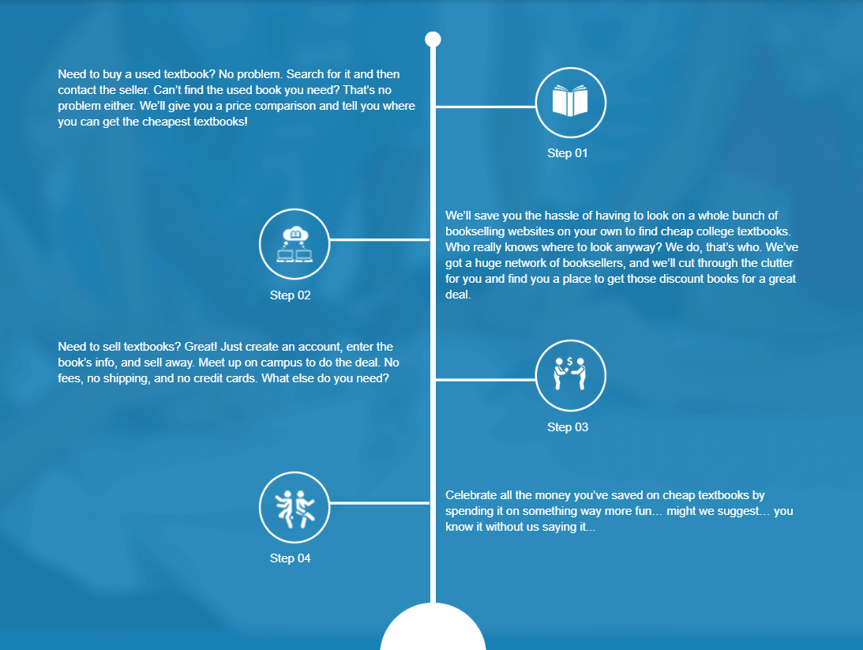
How it works?

Slide 12
MODULES
A module is a software component or part of a program that contains one or more routines.
USER OR BUYER
ADMIN
SELLER
BUYER
ADMIN
SELLER
A User is an individual that purchase the books or get the services by a portal, senior student, alumni, faculties.
The administration of a portal.
All the people who sells the books in portal, senior student, alumni, faculties.

Slide 13
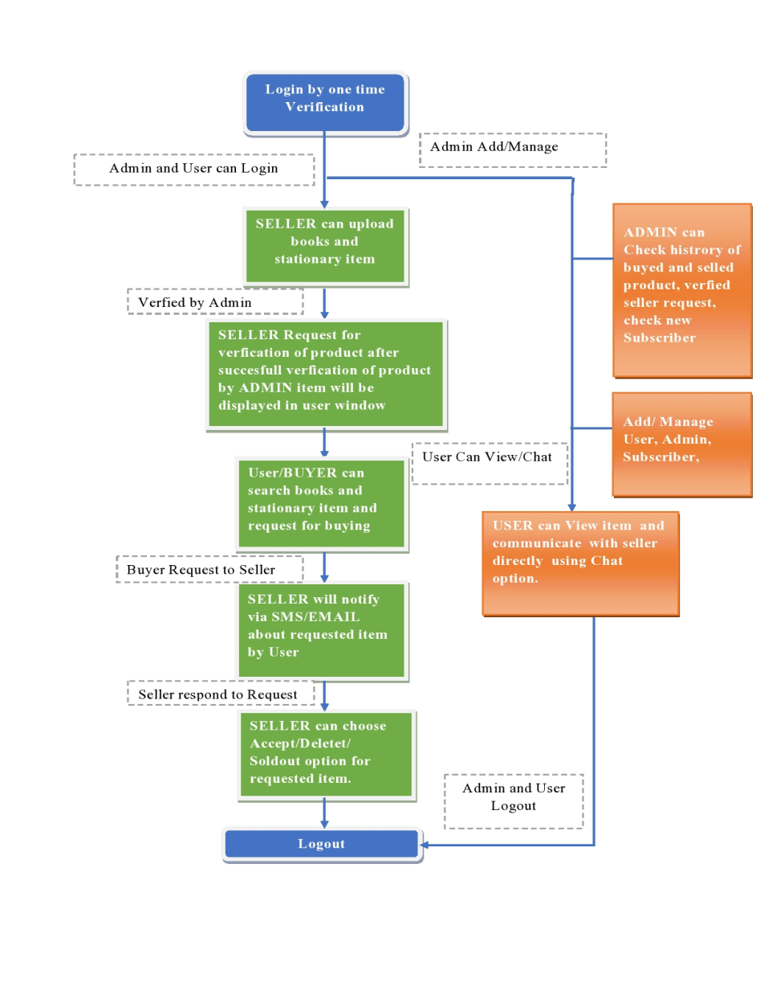
FLOW
DIAGRAM

Slide 14
WORK DONE TILL NOW
A
C
D
B
E
A
Problem statement and Language has be selected.
B
The challenges have been shot-listed which are being facing in the current system.
C
Some of the solutions have been found and some from them some have been even implemented.
D
Work has been distributed individually and everyone started to indulged in it accordingly.
E
Planning, plotting, report, etc. are being discussed

Slide 15
IN OUR MIND
Future ideas that we are going to implement.!!
The details which seller mention will be displayed to user.
The details regarding all the products he/she bought will be displayed in history page.
We’ll try our level best to maintain the relationship between the buyer, seller and admin.
User will be easily connected to seller with SMS notification
All the product details will be displayed.

Slide 16
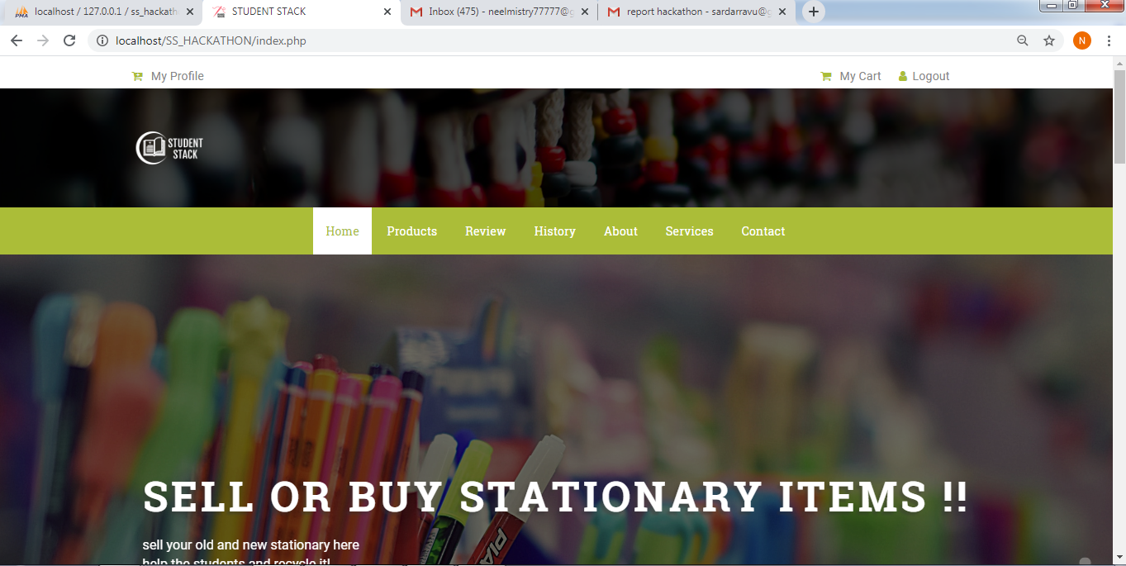
User Panel Dashboard

Slide 17
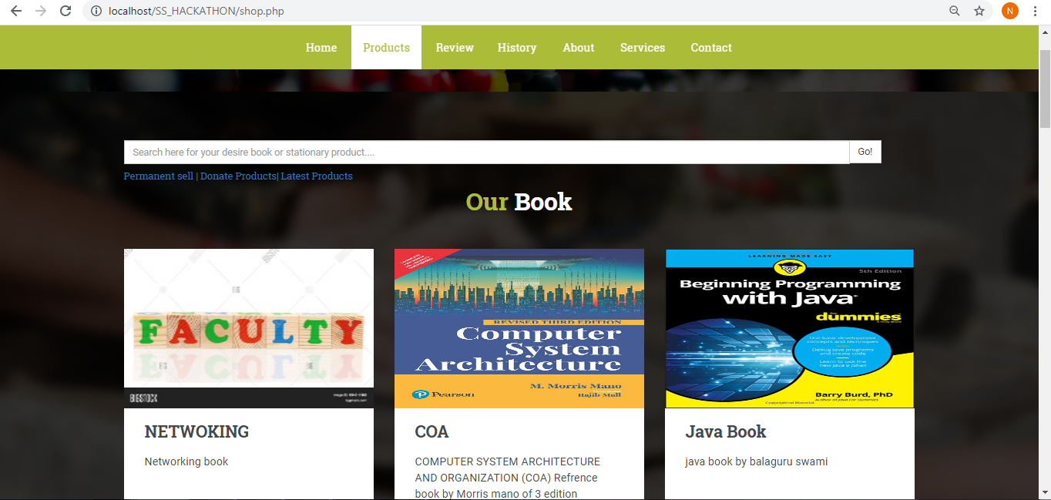
Product show Page
:

Slide 18
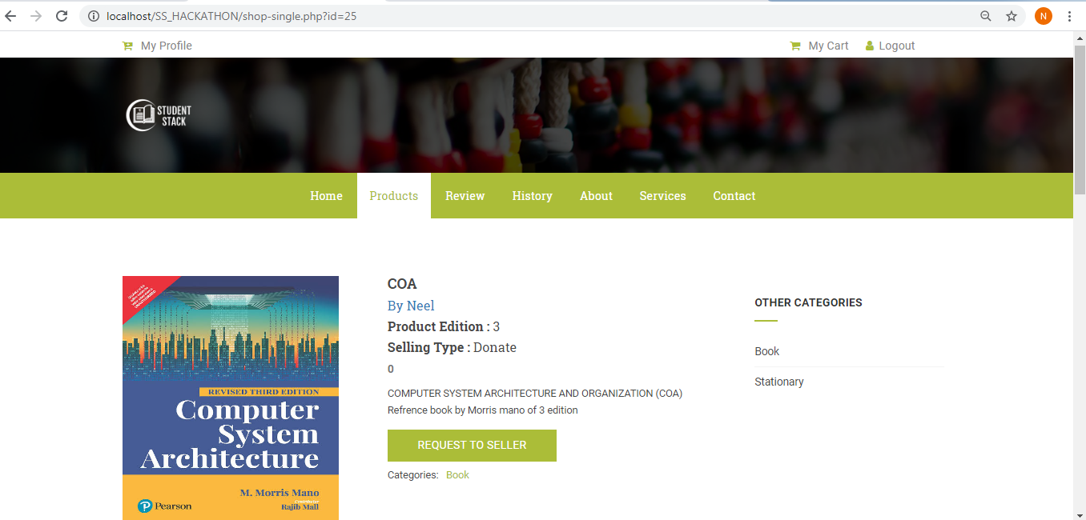
Product Individual Page
:

Slide 19
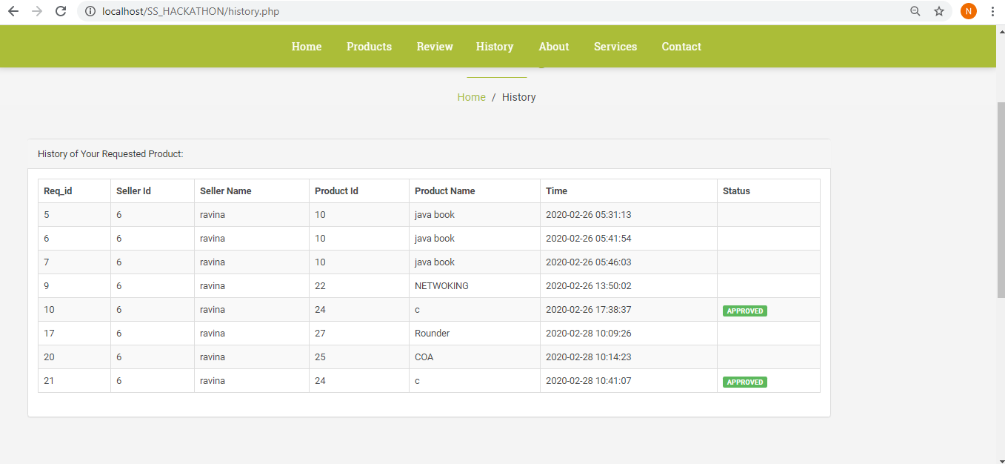
HISTORY PAGE
:

Slide 20
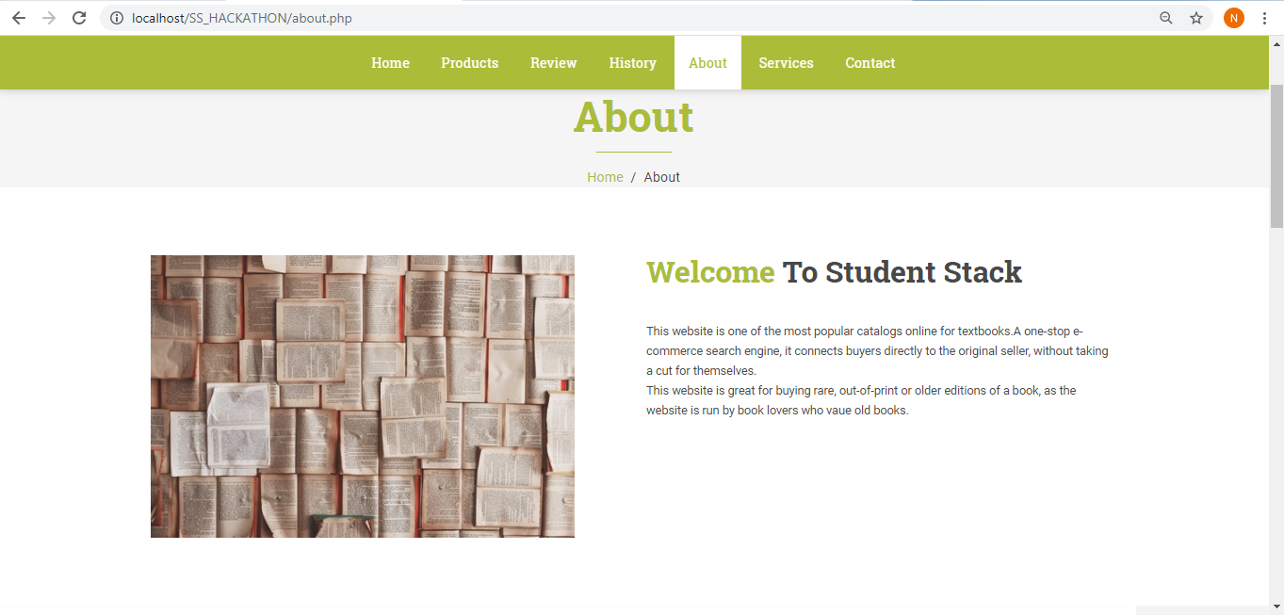
ABOUT
:

Slide 21
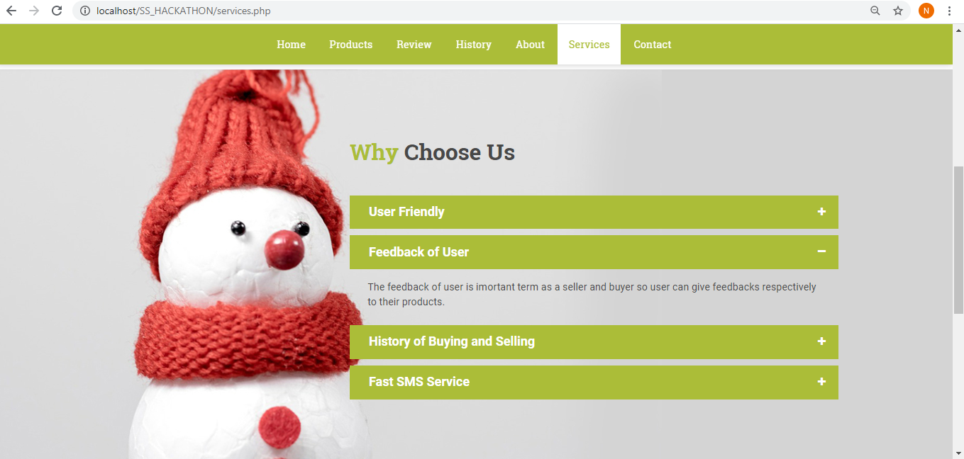
SERVICE PAGE
:

Slide 22
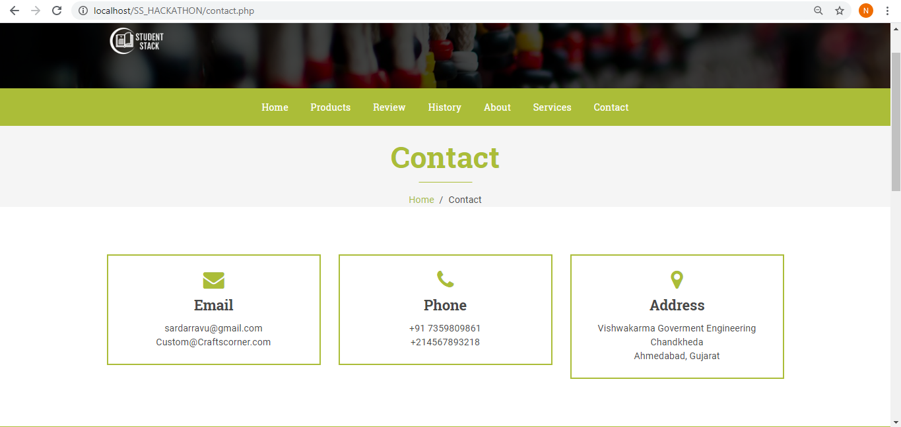
CONTACT FORM
:

Slide 23

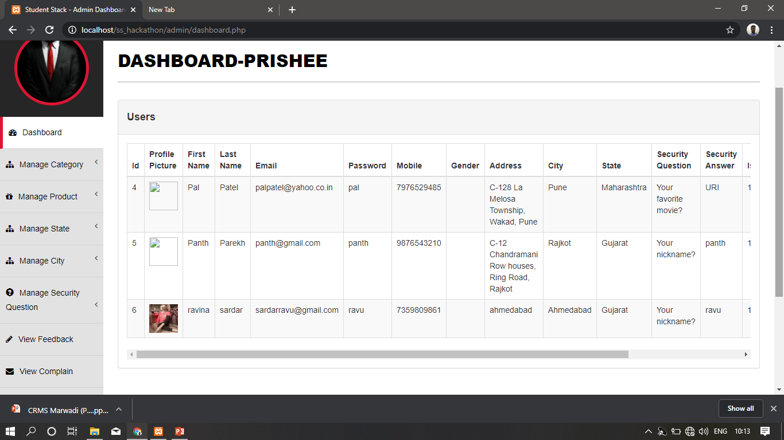
Admin Panel Dashboard
:

Slide 24
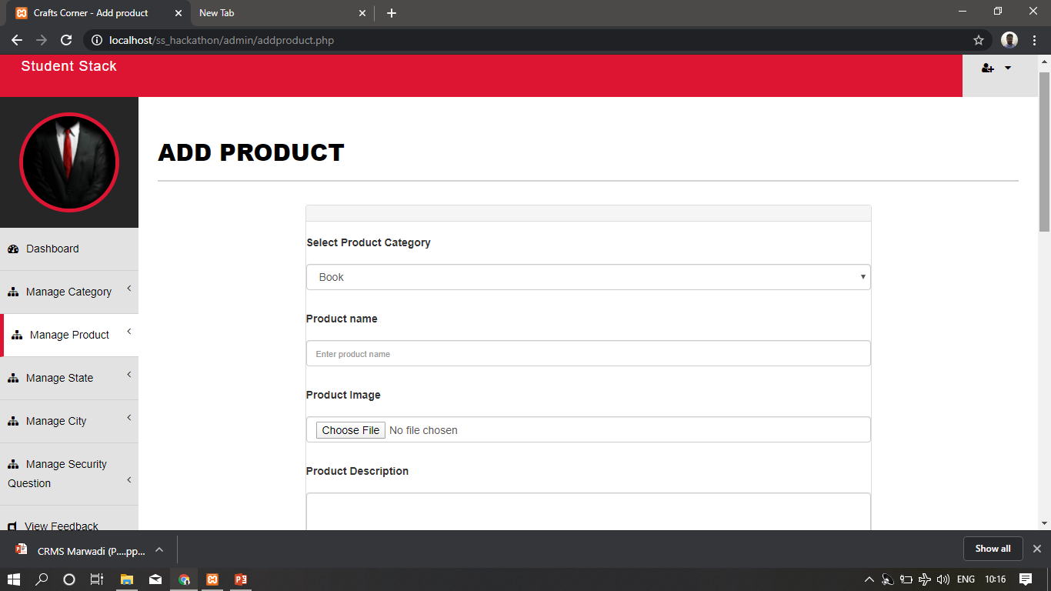
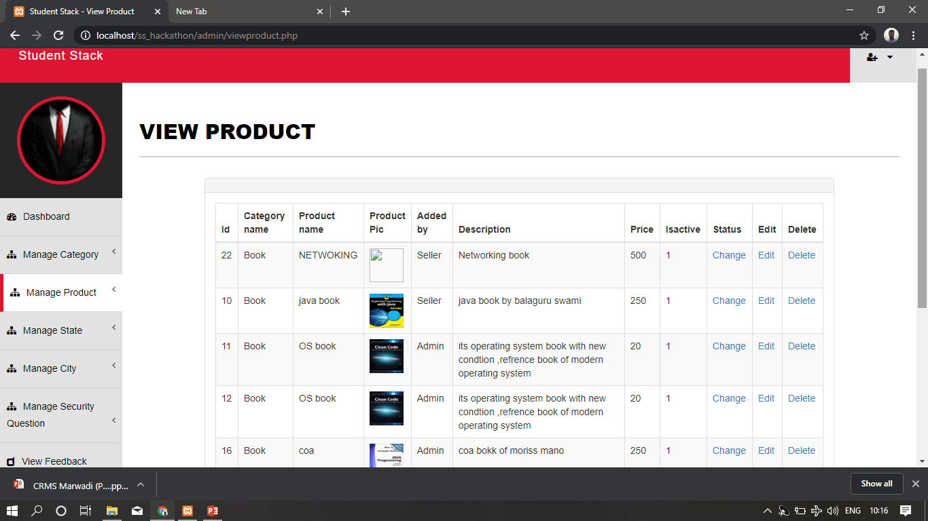
Admin can add product and manage product

Slide 25
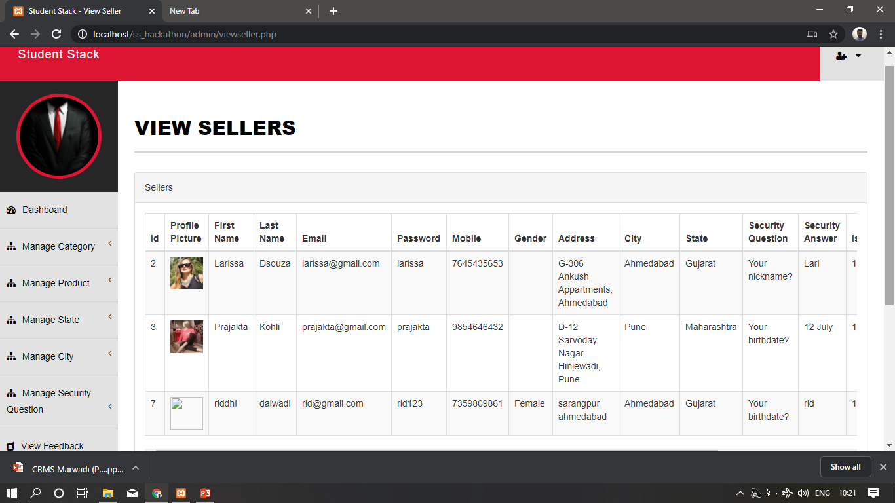
Admin can add seller and manage seller

Slide 26
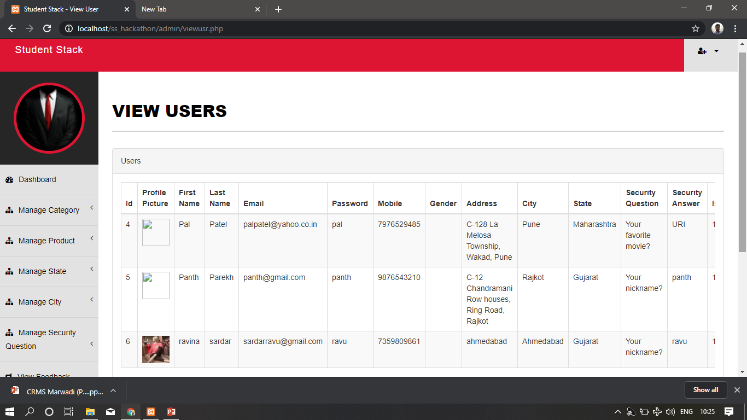
Admin can add staff and manage staff

Slide 27
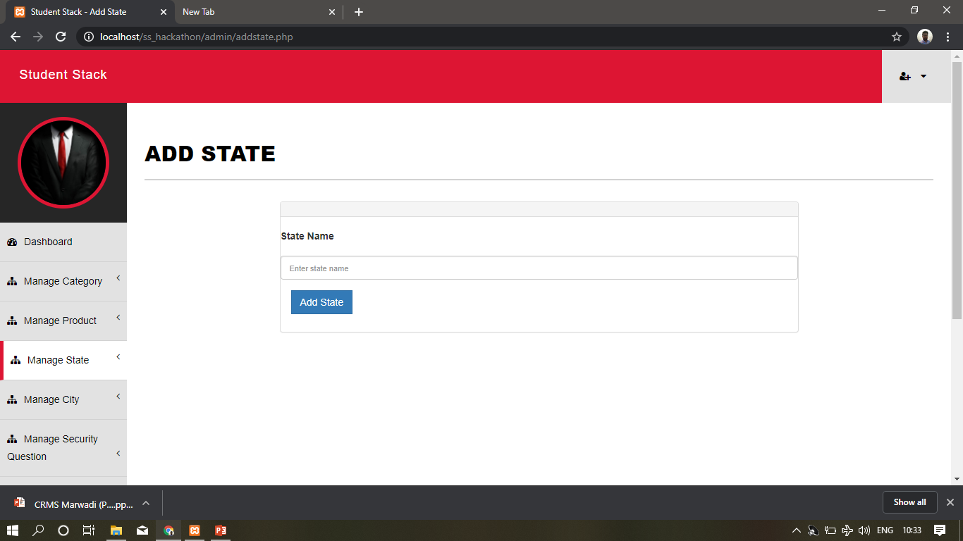
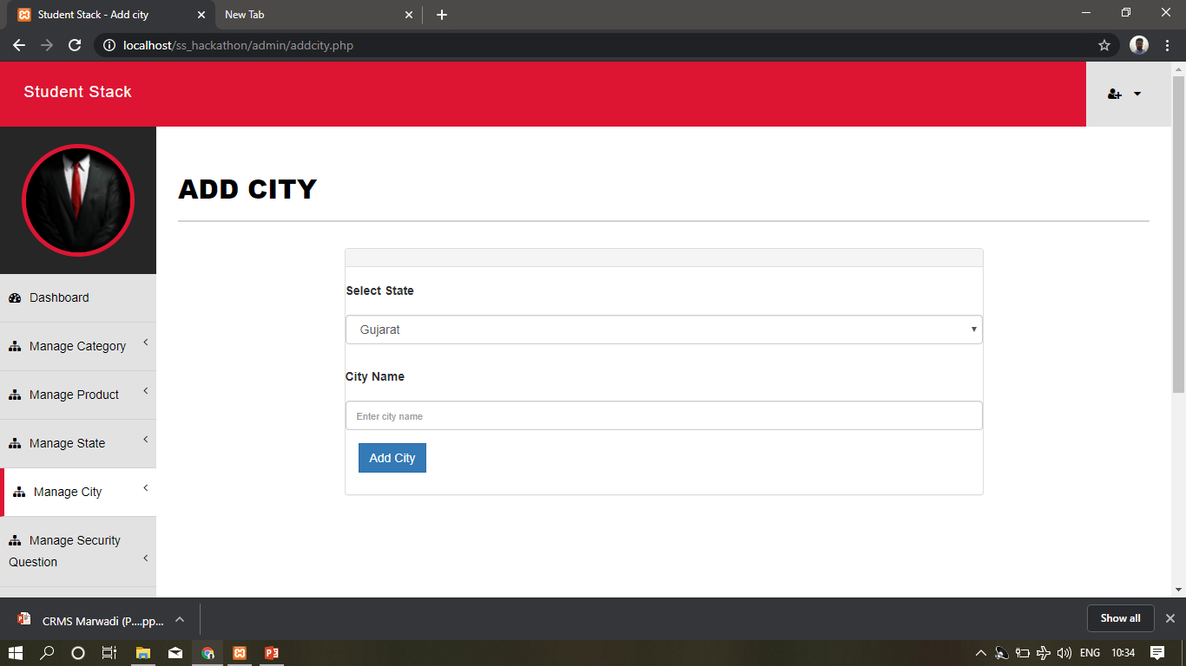
Admin can manage state and city

Slide 28
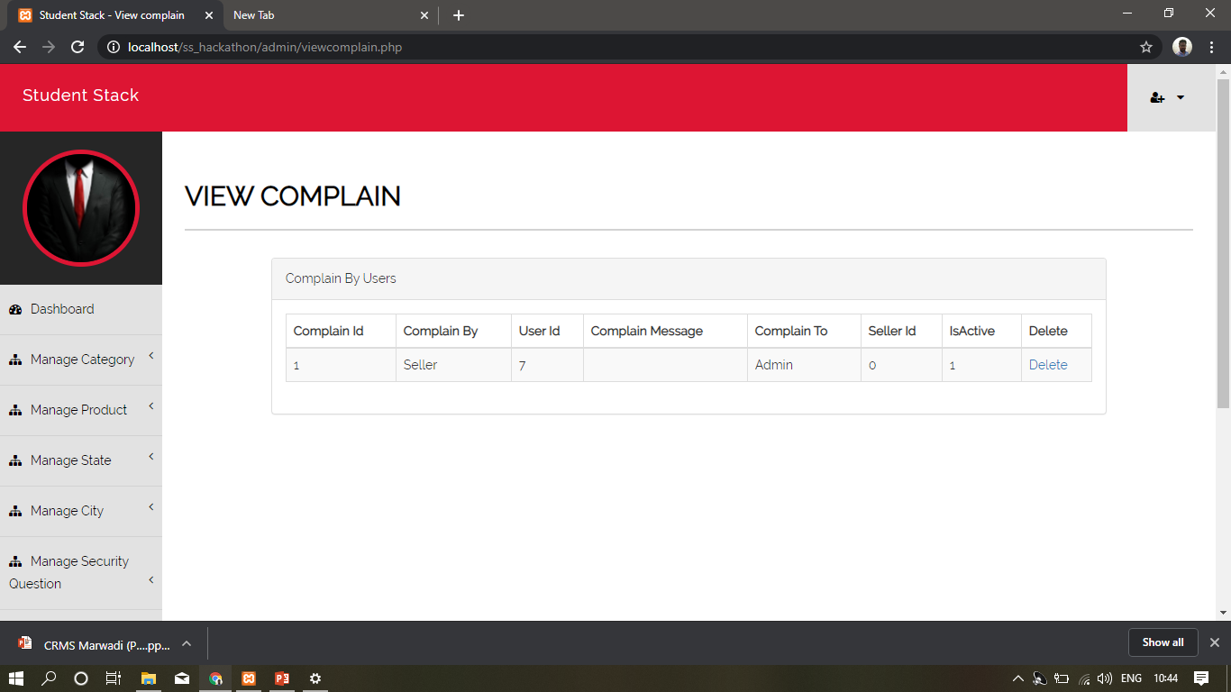
Admin can add complain and manage complain

Slide 29
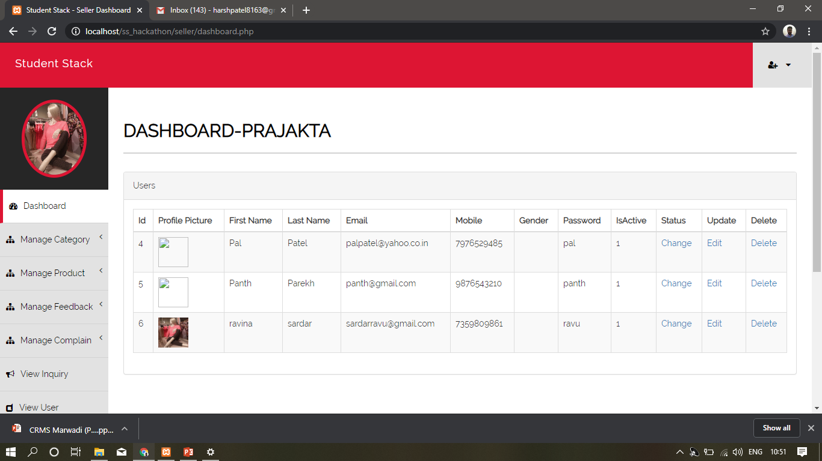
Seller Panel Dashboard

Slide 30
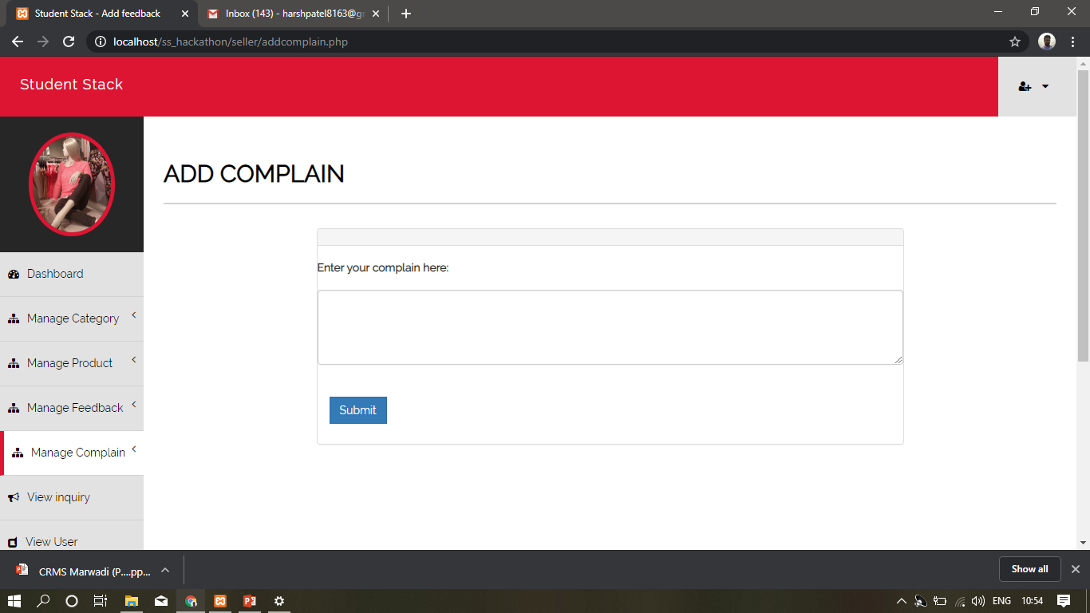
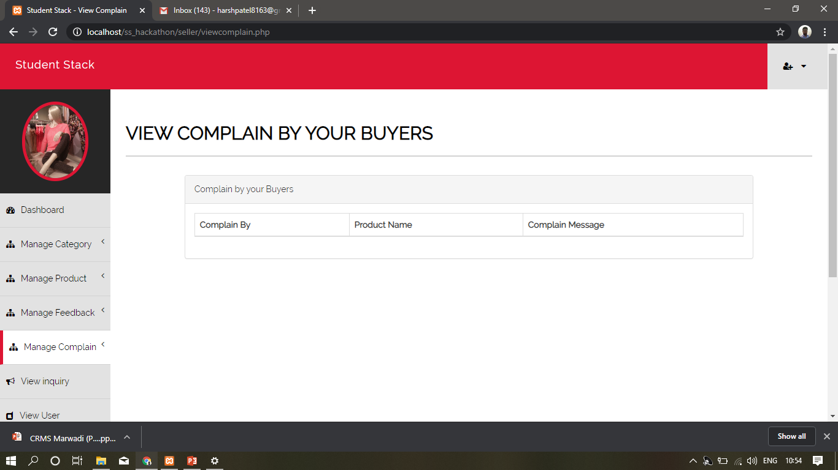
Staff can Manage complains

Slide 31
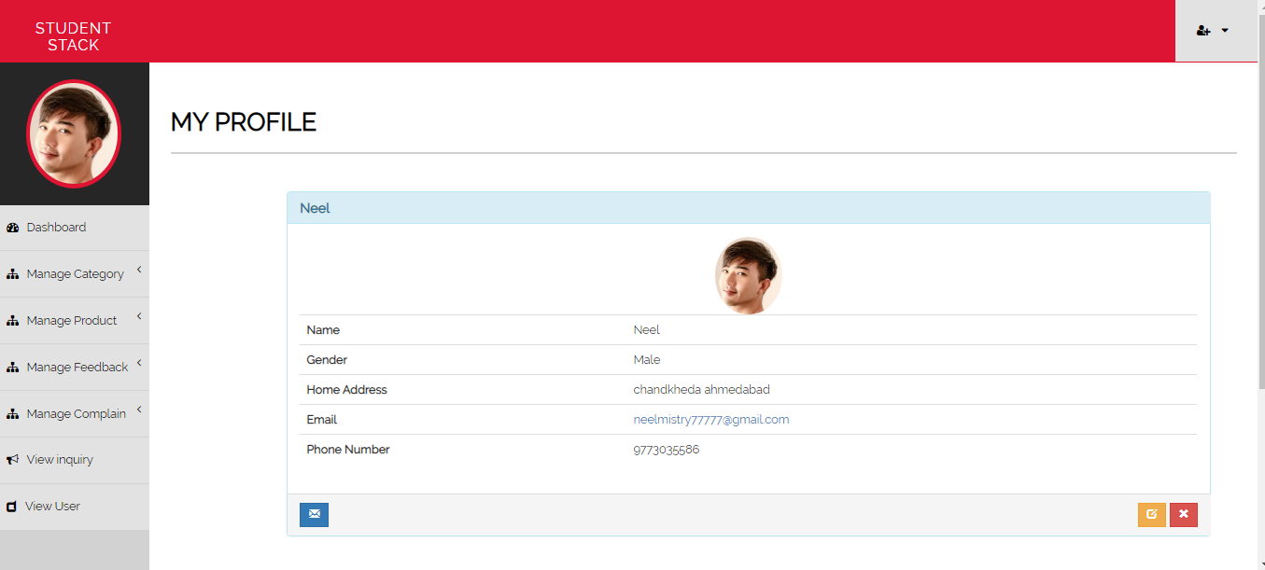
Edit Profile

Slide 32
Thank you
For having us

